Slide 1
Branching Structures and Algorithm conversion to assembly language
Course Code: COE 3205
Course Title: Computer Organization & Architecture
Dept. of Computer Science
Faculty of Science and Technology
Lab No: | 7 | Week No: | 8 | Semester:
Lecturer: | Md. Siyamul Islam Siyamul@aiub.edu

Slide 2
Lab Outline
Branching structures enable a program to take different paths, depending on conditions.
Here, We will look at three structures.
IF-THEN
IF-THEN-ELSE
CASE
Algorithm conversion to assembly language

Slide 3
WRITE AN ASSEMBLY PROGRAM TO PRINT ASCII CODE 0 TO 255
MAIN PROC
MOV CX,255
MOV BL,0
TOP:
MOV AH,2
MOV DL,BL
INT 21H
INC BL
DEC CX
JNZ TOP
MOV AH,04CH
INT 21H
MAIN ENDP

Slide 4
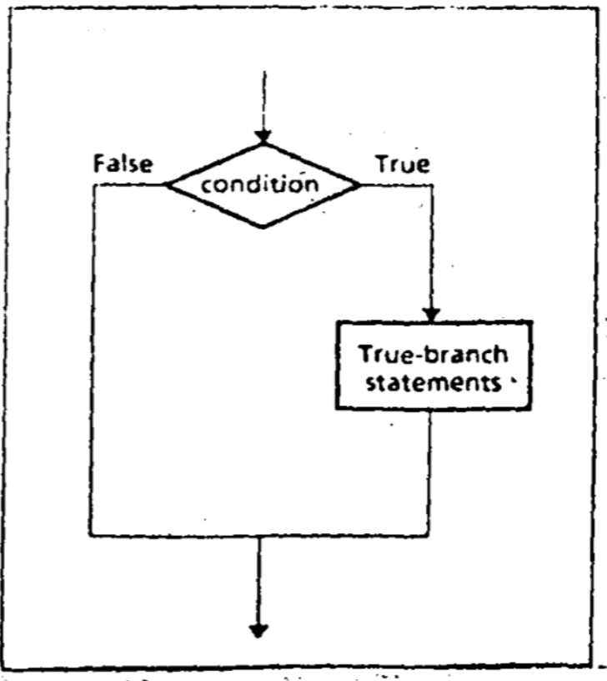
IF-THEN
IF condition is true.
THEN
execute true-branch statements
END_IF

Slide 5
A Pseudo Code , Algorithm and Code for IF-THEN
The condition is an expression that is either true or false.
lf It is true, the true-branch statements are executed.
lf It is false, nothing is done, and the program goes on to whatever follows.
Example: to Replace a number in AX by its absolute value…
IF AX < 0
THEN
replace AX by -AX
END_IF
CMP AX, 0
JNL END_IF
NEG AX
END_IF:

Slide 6
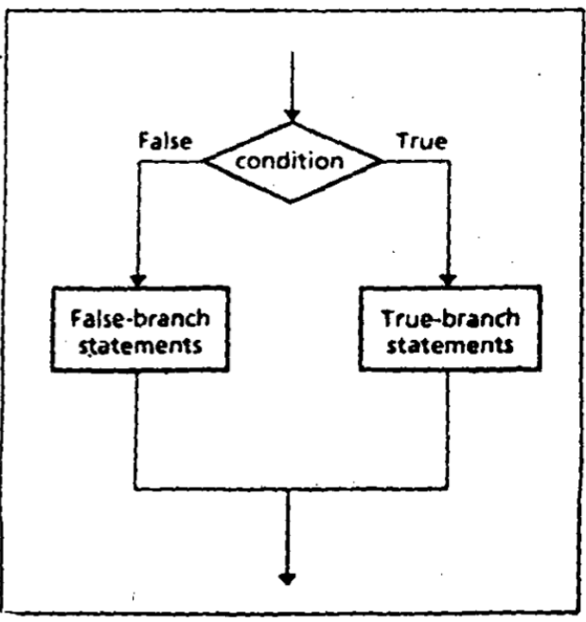
IF-THEN-ELSE
IF condition is true
THEN
execute true-branch statements
ELSE
execute false-branch statements
END_IF

Slide 7
IF-THEN-ELSE
Example: Suppose AL and BL contain extended ASCII characters. Display the one that comes
IF AL <= BL
THEN
Display the character in AL
ELSE
Display the character in BL
END IF
MOV AH,2
CMP AL,BL ;AL<=BL ?
JNBE ELSE_
MOV DL,AL
JMP DISPLAY
ELSE_:
MOV DL,BL
DISPLAY:
INT 2lh

Slide 8
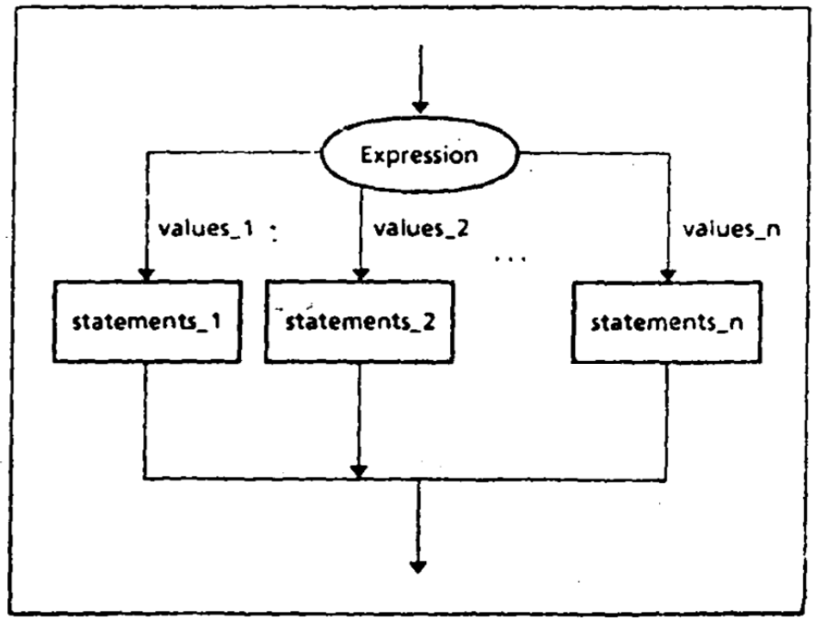
CASE
A CASE is a multi-way branch structure that tests a register, variable, or expression for particular values or a range of values.
CASE Expression
Values_1: Statement_1
Values_2: Statement_2
…
Values_n: Statement_n
END_CASE

Slide 9
CASE
Example: If AX contains a negative number, put -1 in BX; if AX contains 0, put 0 in BX; and if AX contains a positive number, put 1 in BX.
CASE AX
<0 : put -1 in BX
=0 : put 0 in BX
>0 : put +l in BX
END_CASE

Slide 10
CMP AX,O
JL NEGATIVE
JE ZERO
JG POSITIVE
NEGATIVE:
MOV BX,-1
JMP END_CASE
ZERO:
MOV BX,0
JMP END_CASE
POSITIVE:
MOV BX, l
END_CASE:

Slide 11
Lab Tasks
Task: 1
Write a program to convert following code into assembly program.
IF AX < 0
THEN
PUT -1 IN BX
END IF

Slide 12
Lab Tasks
Task: 2
Write a program to convert following code into assembly progam.
IF "AL < 0
THEN
put FFh in AH'
ELSE
put 0 in AH
END_IF

Slide 13
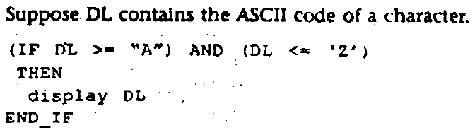
Lab Tasks
Task: 3
Write a program to convert following code into assembly program.

Slide 14
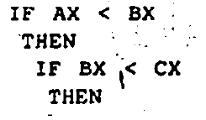
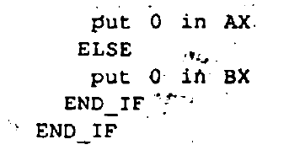
Lab Tasks
Task: 4
Write a program to convert following code into assembly program.

Slide 15
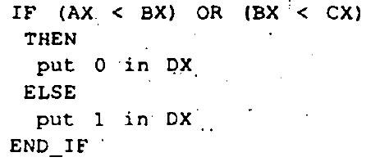
Lab Tasks
Task: 5
Write a program to convert following code into assembly program.

Slide 16
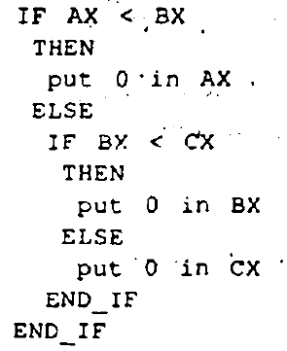
Lab Tasks
Task: 6
Write a program to convert following code into assembly program.

Slide 17
Lab Tasks
Task: 7
Write a program to display "o" if AL contains I or 3; if AL contains 2 or 4, display "e"..

Slide 18
Books
Assembly Language Programing and Organization of the IBM PC
Ytha Yu
Charles Marut

Slide 19
References

